Slide 1
Acids, Bases, and Salts
Chapter 15

Slide 2
Characteristics of Acids and Bases
Acids
sour when dilute (acetic acid, citric acid)
burn skin when concentrated
react with and neutralize bases
react with some metals to form H₂(g)
Bases
bitter when dilute (quinine water, caffeine, milk of magnesia)
corrosive when concentrated
react with and neutralize acids

Slide 3
General Acid Base Definitions
 | Arrhenius | Bronsted-Lowry
Acid | Forms H⁺ in solution | proton donor
Base | Forms OH⁻ in solution | proton acceptor

Slide 4
Acids
Form H⁺ or H₃O⁺ in solution.
HA ↔ H⁺ + A­
or
HA + H₂O ↔ H₃O⁺ + A­

Slide 5
Bases
Forms OH⁻¹ in solution.
BOH ↔ B⁺¹ + OH^{­1} or
B + H₂O ↔ BH⁺¹ + OH^{­1}

Slide 6
Acids

Slide 7
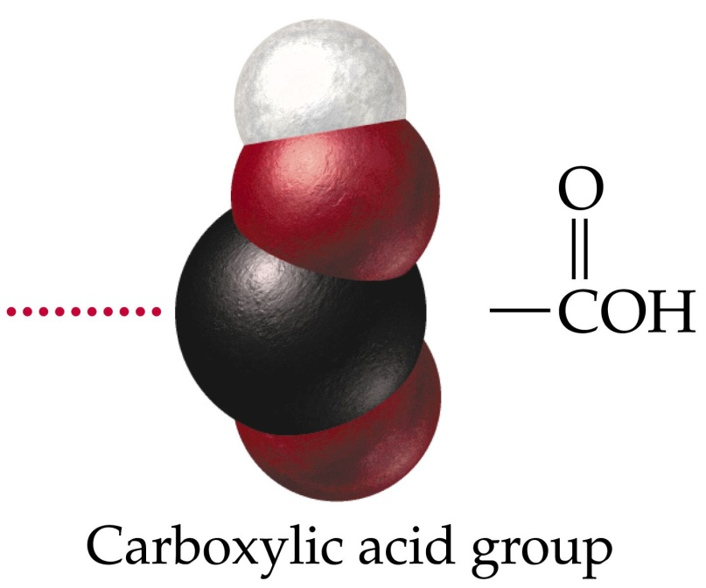
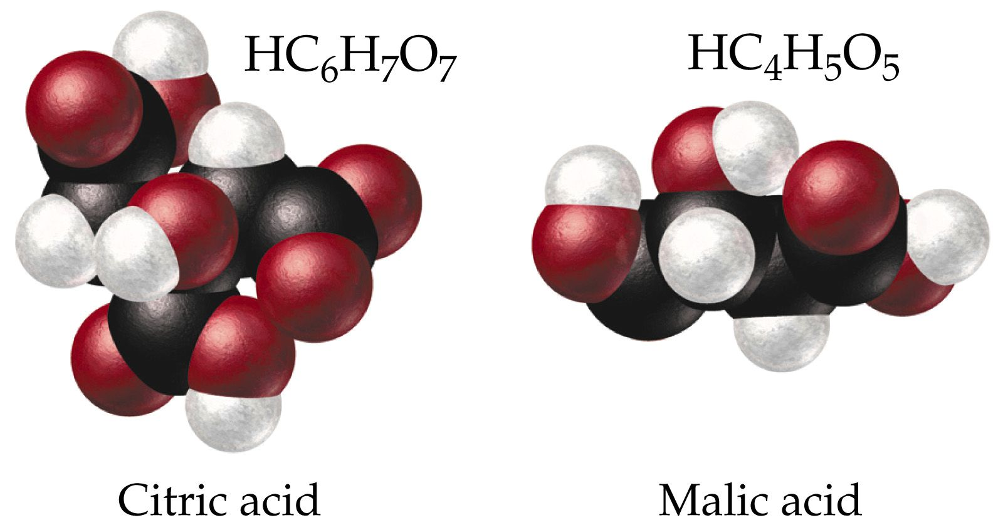
Organic acids frequently contain a carboxylic acid group

Slide 8
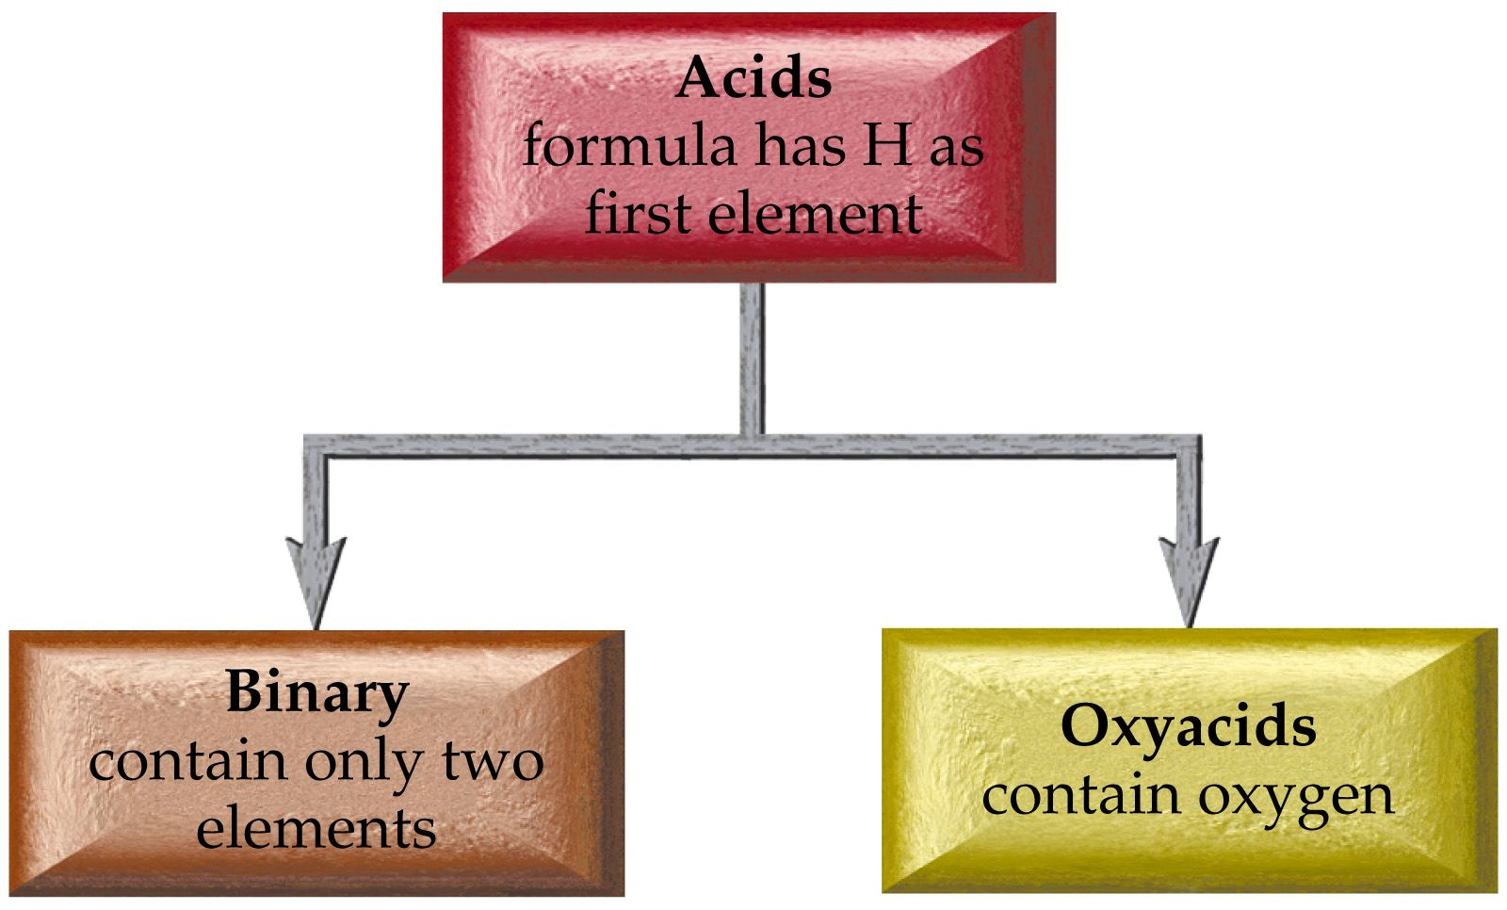

Slide 9
Acid Nomenclature
Binary Acids
HX hydrogen _____ide
becomes
Hydro______ ic acid

Slide 10
HCl(g) hydrogen chloride
HCl (aq) hydrochloric acid
H₂S(g) hydrogen sulfide
H₂S(aq) hydrosulfuric acid
HCN(g) hydrogen cyanide
HCN(aq) hydrocyanic acid

Slide 12
Oxyacid Nomenclature
Hydrogen ___ate → ___ic acid
Hydrogen ___ite → ___ous acid
Hydrogen per __ate → per__ic acid
Hydrogen hypo__ite →hypo__ous acid

Slide 13
H₂SO₄ sulfuric acid
H₂SO₃ sulfurous acid
H₂CO₃ carbonic acid
HClO hypochlorous acid
H₂TeO₃ tellurous acid
HBrO₄ perbromic acid

Slide 14
Acid Base Reactions
Conjugate acid base pair
HA + B ⬅➔ A­ + BH⁺
acid base base acid
Acid HA ➔ Conjugate base A­
Base B ➔ Conjugate acid BH⁺

Slide 19
pH is a method used to describe the concentration of H₃O⁺(H⁺) in a solution easily.
pH = ­log[H₃O⁺]
where [H₃O⁺] = concentration of H₃O⁺ in mol/L or molarity (M)

Slide 20
The pH scale
pH = 7 ➔ neutral
pH > 7 ➔ basic solution
pH < 7 ➔ acidic solution

Slide 21
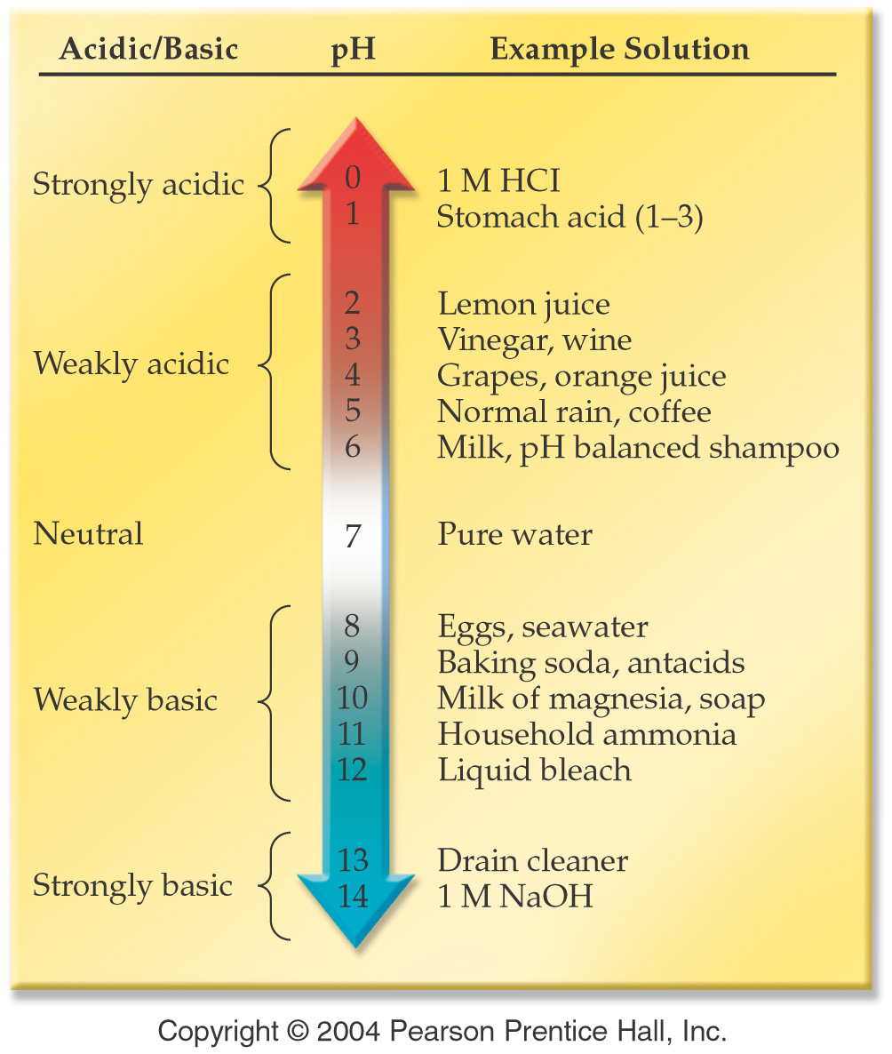

Slide 22
Classify each of the following foods as acidic, basic or neutral
egg white, pH = 7.9
maple syrup, pH = 7.0
champagne, pH = 3,8
sour milk, pH = 6.2
lime juice, pH = 1.8
tomato juice, pH = 4.1

Slide 23
What is the pH of A 0.10 M solution of HCl with [H₃O⁺] = 0.10 M

Slide 24
A bottle of table wine has [H₃O⁺] = 3.2 x 10⁻⁴ M. After one month the [H₃O⁺] rises to 1.0 x 10⁻³ M. Calculate the pH of the new and old bottle of wine and explain the changes observed.

Slide 25
Calculate the pH of carrot juice with a hydronium ion [H₃O⁺]concentration of 7.9 x 10⁻⁶M.

Slide 26
Calculate the pH of pea juice with a hydronium ion [H₃O⁺]concentration of 3.9 x 10⁻⁷M.

Slide 27
What is the pH of pure water? [H₃O⁺] = [OH⁻] = 1.0 x 10⁻⁷ M

Slide 28
In pure water
H₂O + H₂O ⬅➔ H₃O⁺ + OH­
[H₃O⁺] = [OH⁻] = 1.0 x 10⁻⁷ M
[H₃O⁺] × [OH⁻] = 1.0 x 10⁻¹⁴ M²

Slide 29
What is the pH of a 0.10 M NaOH solution with [OH-] = 0.10 M?
What is the pH of a 0.024 M NaOH solution?

Slide 30
pOH
pOH = ­log[OH­]
What is the pOH of a solution that is 4.87 ×10⁻⁹ M in NaOH?

Slide 31
What is the [H₃O⁺] concentration of a solution with pH = 4.22?

Slide 32
[H₃O⁺¹] | [OH⁻¹] | pH | pOH
5.98 x 10⁻¹¹
 | 9.63 x 10⁻⁵
 |  | 9.092
 |  |  | 10.05

Slide 33
How many mL of a 0.5223 M solution of NaOH is required to completely react with 3.457 g of oxalic acid (H₂C₂O₄)?

Slide 34
If 58.70 mL of HCl solution were used to titrate 1.077 g of NaOH, what was the molarity of the HCl solution?

Slide 35
A 25.00 mL sample of vinegar was titrated with 23.55 mL of a 0.4233 M sodium hydroxide solution. What is the concentration of acetic acid in the vinegar solution?

Slide 36
A 50.00 mL aliquot of phosphoric acid was titrated with 37.29 mL of 0.5277 M potassium hydroxide. Write the equation for the reaction that takes place and calculate the molarity of the phosphoric acid solution.

Slide 37
Buffers
Compounds that help to maintain a constant pH
Buffers work by reacting with both acids and bases

Slide 38
Bicarbonate Buffer
Bicarbonate reacts with acid
HCO₃⁻¹ + H⁺¹ → H₂CO₃
Bicarbonate reacts with base
HCO₃⁻¹ + OH⁻¹ → CO₃⁻²
Both acid and base can be neutralized by bicarbonate

Slide 39
